Slide 1




Astrosage
Analysis
Ram Kumar
25. 06. 2026

Slide 2

Introduction to Astrosage
AstroSage is a website and app that provides astrology services, including horoscope matching, birth chart generation, and AI astrologers.
AstroSage is used by many astrologers to create birth charts and match horoscopes.
AstroSage is used by Hindus to make decisions about marriage, opening a business, or moving to a new home .

Slide 3


Data Overview
  There are 4 different consolation service that Astrosage offers
  In total 149 Consultants are avialable.
  A good dataset is important to understand the operational cost , customer satisfaction and trend in the sales of call center.
  This dataset enable us to predict and suggest future investments to grow the sales Turnover.

Slide 4
Methodology
  Data Cleaning -: Used spreadsheets functions like trim and Removing duplicates for data cleaning.
  Data Enrichment -: Added new variables using Date functions for better analysis .
  Customer Segmentation -: Used Sorting and Filtering to classify customers based on consultation type.
  Used Pivot tables to analyze the performance of consultants over different category type and ratings received on basis of consultations from users.
  Visualization -: Created interactive dashboard using different charts for detailed view of dataset.

Slide 5
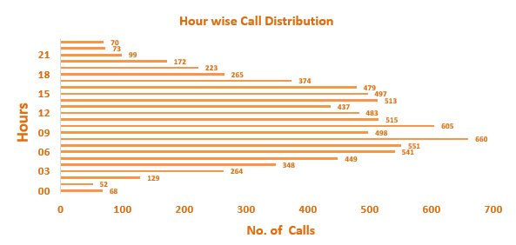
Key Metrics
  The above graph shows the hour wise call distribution.
  660 calls are the most in a single an hour .
  The mid-morning hours generally receives more number of calls round the whole day
as per the dataset.

Slide 6
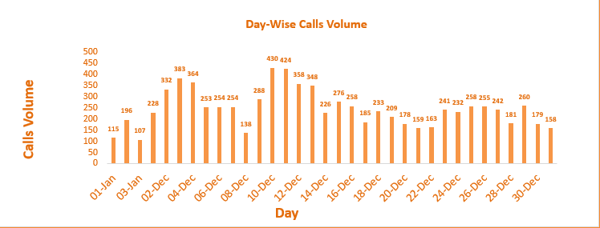
Key Metrics
  The above graph shows the Day-wise call distribution.
  430 calls is the maximum amount of call received on a single day.
  On an average the call center receives around 246 calls on a daily basis.

Slide 7
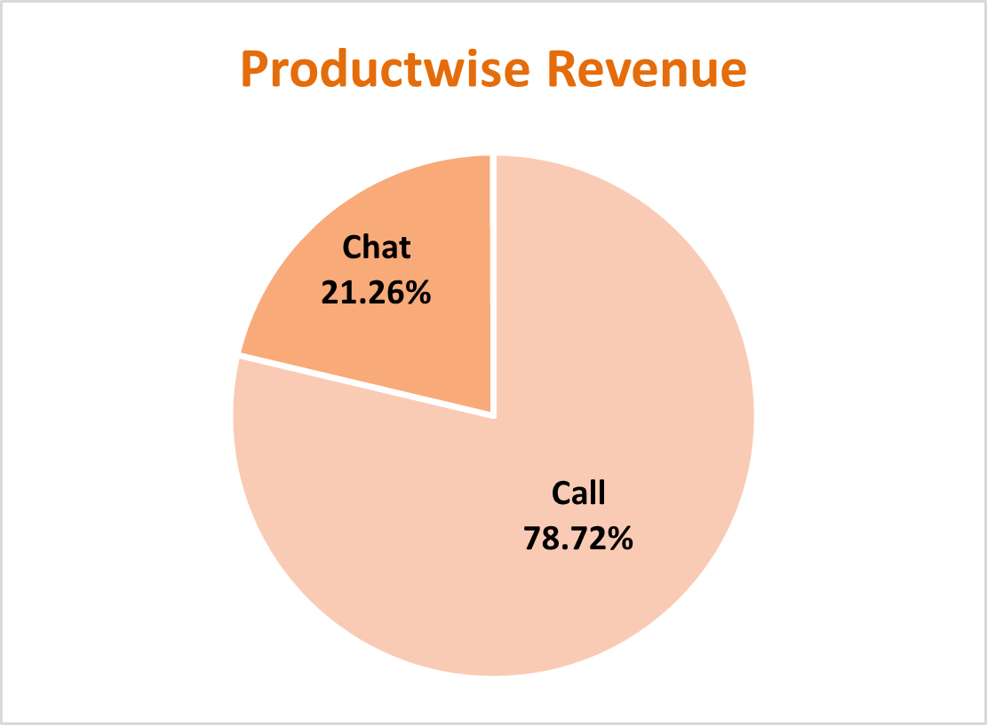
Key Metrics
  Product-wise revenue Pie Chart , presents a detailed insight about the revenue generated by different consultation-types as per the percentage of total revenue.
  Product-wise revenue Pie Chart , presents an impactful insight that the calls consulation are most profitable.

Slide 8
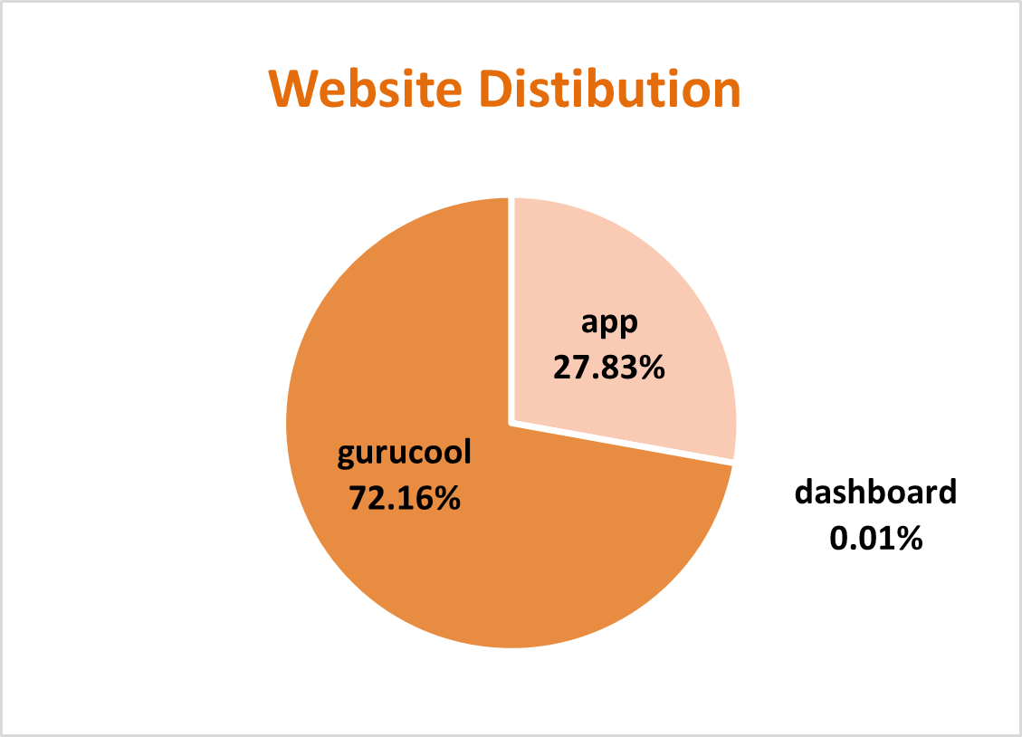
Key Metrics
  The website distribution pie chart is presented with the different websites showing count consultations through different website chanells.
  The least amount of consultations appear from dashboard.
  The most amount consultations are from gurucool.

Slide 9
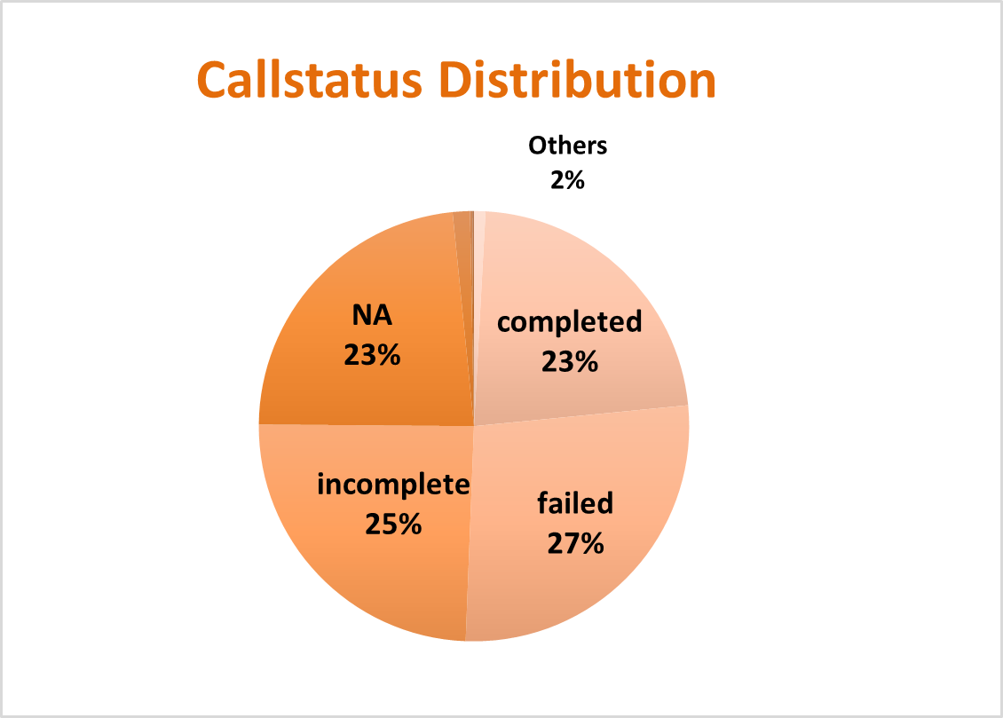
Key Metrics
  The call-status pie chart is presented with the different responses by the user i.e. the end result of consultation.
  The completed calls are 25%
  There are the most amount failed calls.
  The NA represents the consultations done on any other consultation-type than calls.

Slide 10
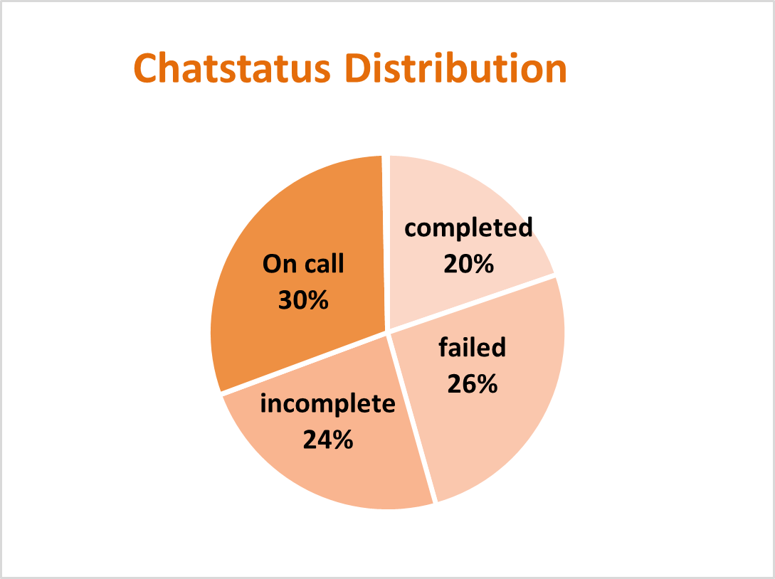
Key Metrics
  The chat-status pie chart is presented with the different responses by the user i.e. the end result of consultation.
  The completed chats are 20%
  There are the most amount failed chats.
  The On call represents the consultations done on any other consultation-type than calls.

Slide 11
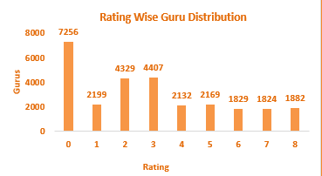
Key Metrics
  The column chart represents the rating-wise guru distribution.
  The ratings of Gurus that consulted on chats is better than on calls.
  The calls consultation needs to be worked on and improve to increase the quality of consultation.

Slide 12
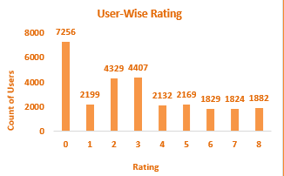
Key Metrics
  The column chart represents the rating-wise user distribution.
  The ratings of users who were consulted on chats is better than on calls.
  The calls consultation needs to be worked on and improve to increase the quality of consultation.

Slide 13
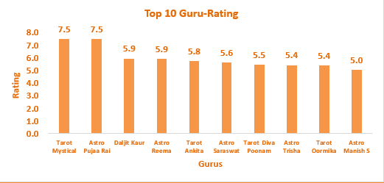
Key Metrics
  The column chart represents the Top-rated Gurus.
  7.5 is the average highest rating received by the Tarot Mystical and
Astro Puja Rai.
  The average rating of the Top 10 Gurus is 5.5.

Slide 14
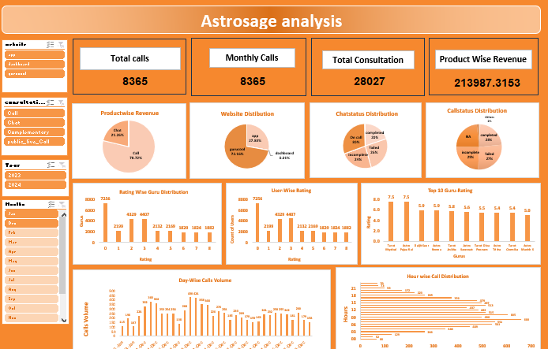

Slide 15

Strategic Initiatives
1. Enhance Technology & User Experience
Improve app/dashboard performance to increase user engagement
Reduce cancelled and failed consultations to boost profitability
2. Optimize Operations & Cost Efficiency
Focus on call consultations to drive higher revenue
Use chatbots/virtual assistants for basic queries to reduce consultant workload and operational costs
3. Improve Service Quality & Consistency
Allow users to choose consultants and collect feedback
Share top-rated session recordings and conduct regular training to maintain quality standards

Slide 16
RECOMMENDATIONS
Upgrade Technology: Improve app and dashboard performance to increase user engagement and reduce failed or cancelled consultations.
Implement Pre-booking and CRM Systems: Enhance efficiency and reduce repetitive processes.
Use Chatbots and Virtual Assistants: Handle basic queries to lower operational costs and free consultants for peak hours.
Focus on Call Consultations: Drive higher revenue and improve customer interaction.
Enable Consultant Selection and Feedback: Allow customers to choose consultants and provide feedback to build trust.
Ensure Training and Quality Consistency: Share top-rated session recordings and conduct regular training to maintain service standards.

Slide 17
Conclusion
  Upgrading technology and streamlining operations can enhance profitability and customer satisfaction.
  Introducing pre-booking and CRM systems will improve efficiency and reduce repetitive processes.
  Using chatbots for general queries will lower operational costs and reserve consultants for peak hours.
  Focusing on call consultations can increase revenue and customer engagement.
  Allowing customers to choose consultants and collecting feedback will build trust and loyalty.

